Slide 1

AMAZON
E-COMMERCE ANALYSIS
Optimising e-Commerce Performance through Data-Driven Insights
Presented by: Amar

Slide 2
Agenda
Problem Statement
Data Description
Objective Key Metrics and Visualizations
Subjective Question for Insights

Slide 3
Introduction
Amazon is a global leader in e-commerce, offering a vast range of products and services, including retail, cloud computing, and entertainment. Renowned for its customer-centric approach, innovative technologies, and efficient delivery systems, Amazon has revolutionized online shopping, making it convenient, reliable, and accessible worldwide.

Slide 4
Problem Statement
Amazon, an E-commerce company currently performing well. The stakeholders wish to maintain this level of performance and seek an improvement with new strategies.
Other than discounts and Prime membership perks, the company wants additional methods to identify and reward customers and enhance their shopping experience.

Slide 5
Approach
Revenue Distribution Analysis
Periodic And Geographical Analysis
Product Analysis
Customer Satisfaction Analysis
Customer Service Analysis

Slide 6



Key Performance Indicators
The total Revenue generated
The total number of Unique Customers
Unique Products that are sold

Slide 7
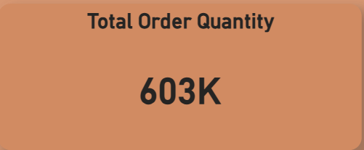
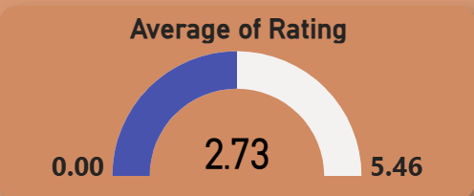
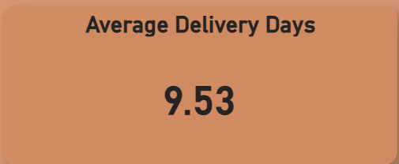
Key Performance Indicators
Total Number of Order Quantity
Overall Average Rating
Average Delivery Time taken to deliver the products

Slide 8
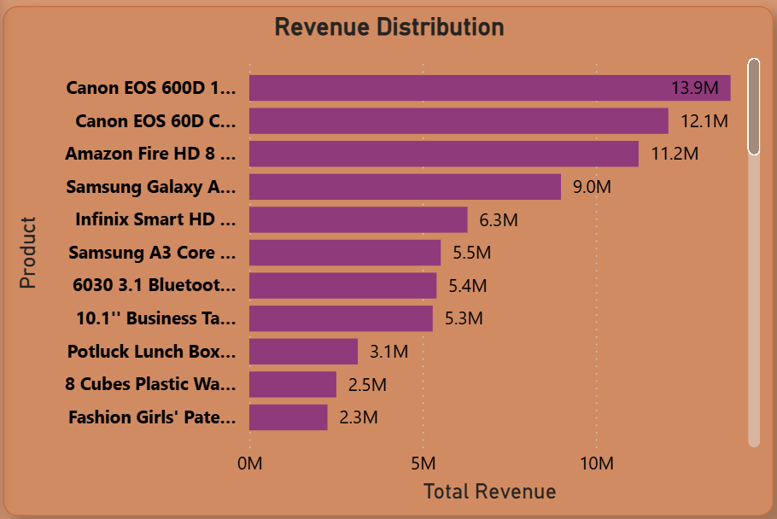
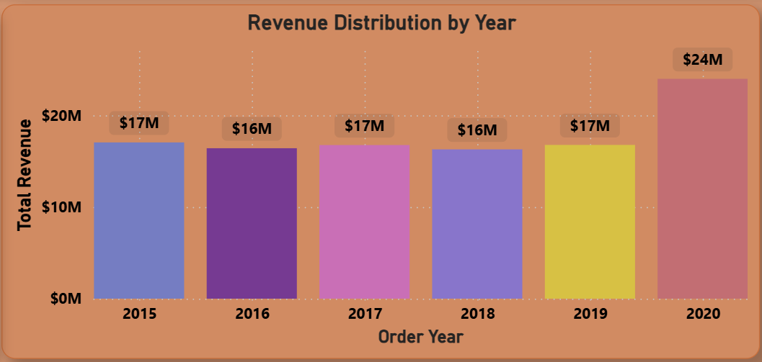
Revenue Distribution Analysis
Key takeaways:
With revenue distribution, we can understand which product contributing more to the revenue and also in which year revenue generated more.
Revenue generated in the year 2020 is more compared to previous years.
Top revenue generated product is Canon EOS 600D 18MP DSLR Camera- Black with 14M sales.

Slide 9
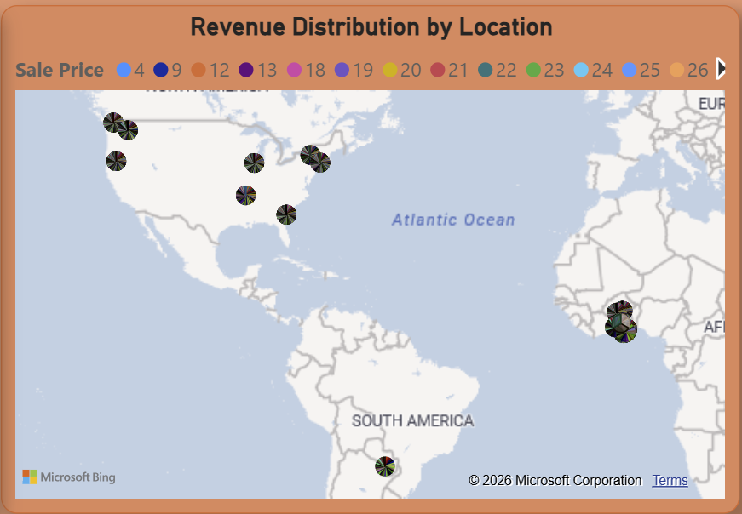
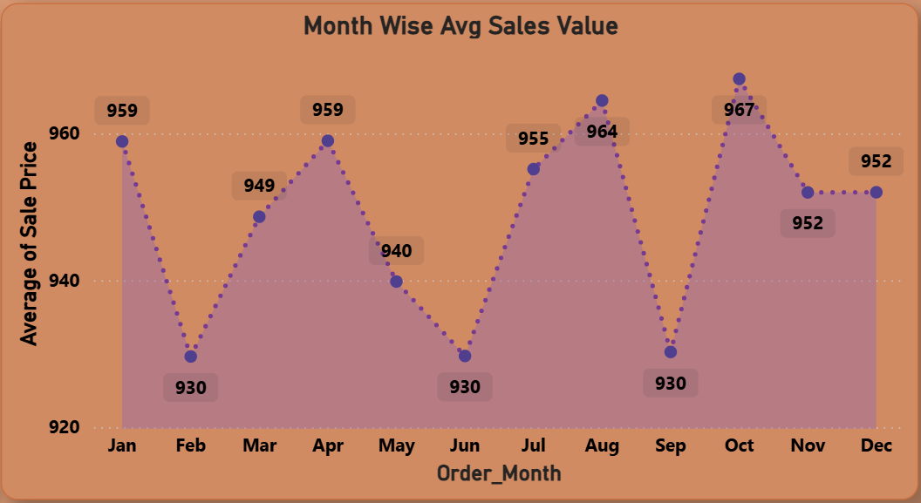
Periodic And Geographical Analysis
Key takeaways:
Periodic and geographic analysis supports targeted marketing and optimized distribution strategies.
Average sales declined in February, June, and September.
North America and Africa are the leading contributors to revenue.
South America contributes the least to overall revenue

Slide 10
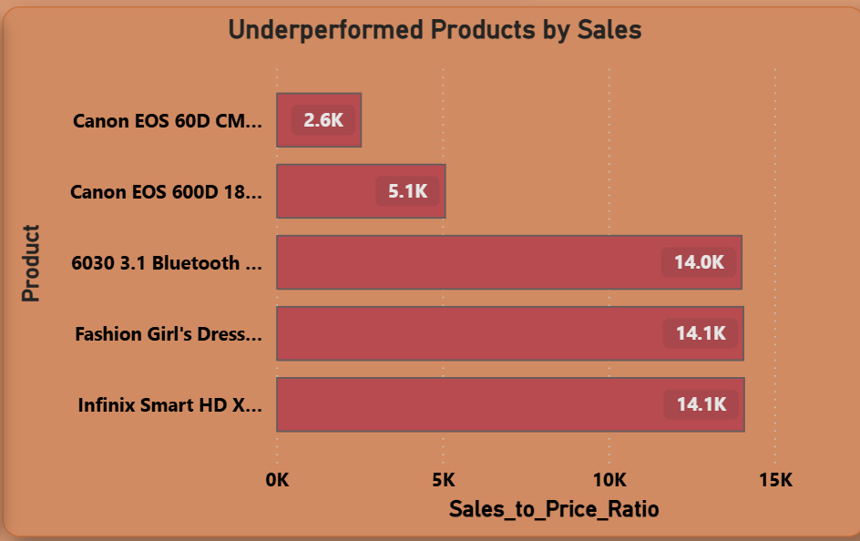
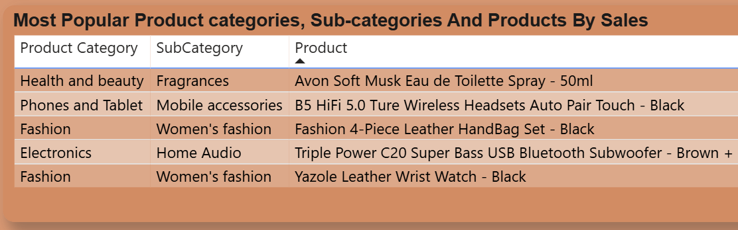
Product Analysis
Key Takeaways
Product analysis highlights both top-performing and underperforming products.
A clear gap exists between high-demand products and low-performing ones.
Underperforming products may require targeted marketing to improve sales performance.

Slide 11
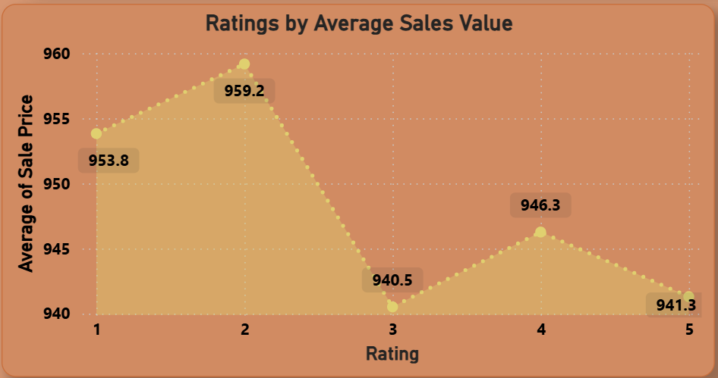
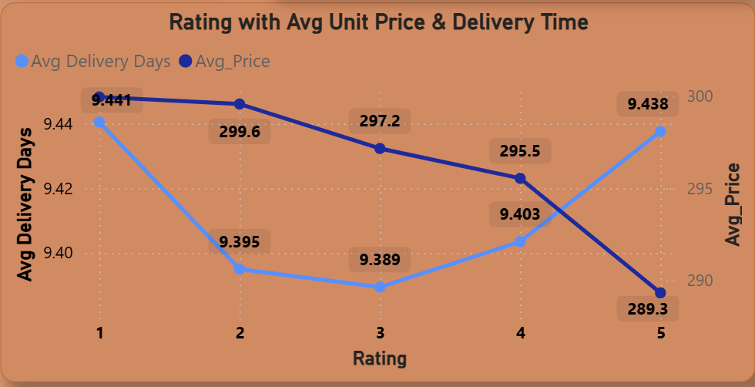
Customer Satisfaction Analysis
Key Takeaways
Customer satisfaction reflects engagement with the platform and overall shopping experience.
The average customer rating is 2.73, indicating moderate satisfaction.
Low-priced products tend to receive 4–5 star ratings.
Shorter delivery times are associated with higher customer ratings.

Slide 12
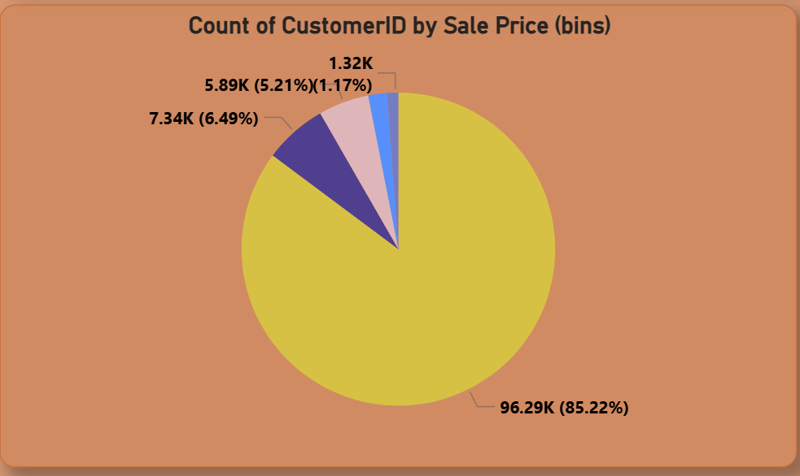
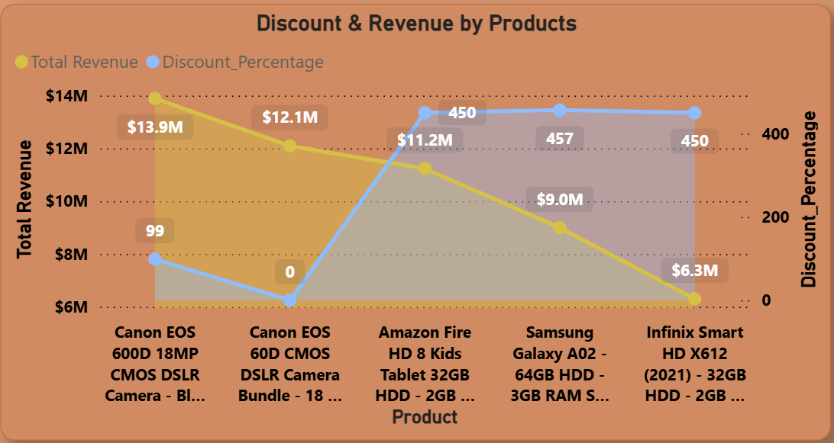
Customer Loyalty Program
Key Takeaways
Customer loyalty programs can encourage repeat purchases and increase engagement.
Customer segmentation shows 85.22% fall into the low-spending group.
High-revenue products currently receive low average discounts.
Strategic discounts on these products could further boost sales and revenue.

Slide 13
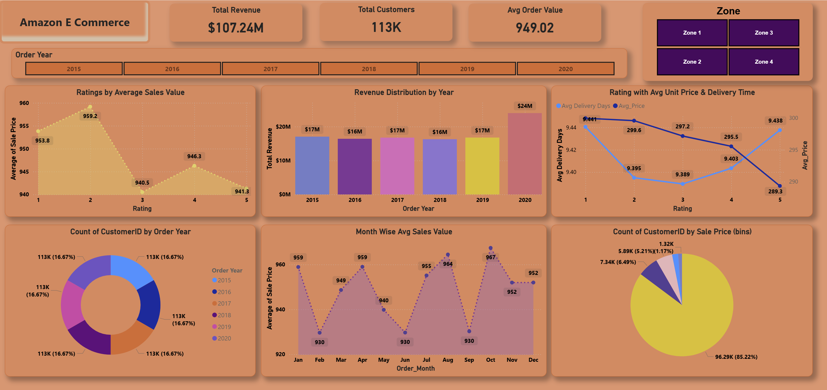
Report – Main Tab

Slide 14
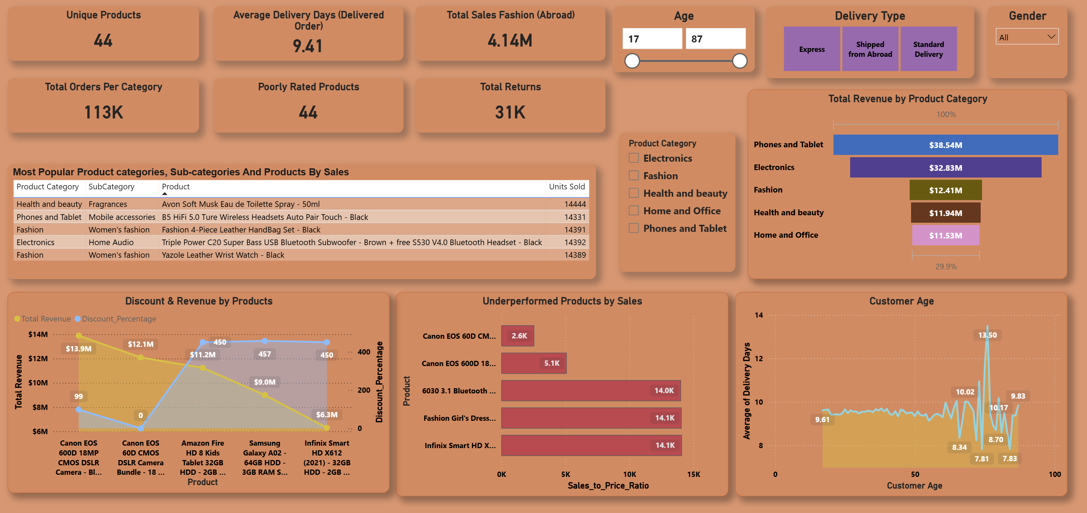
Product Tab

Slide 15
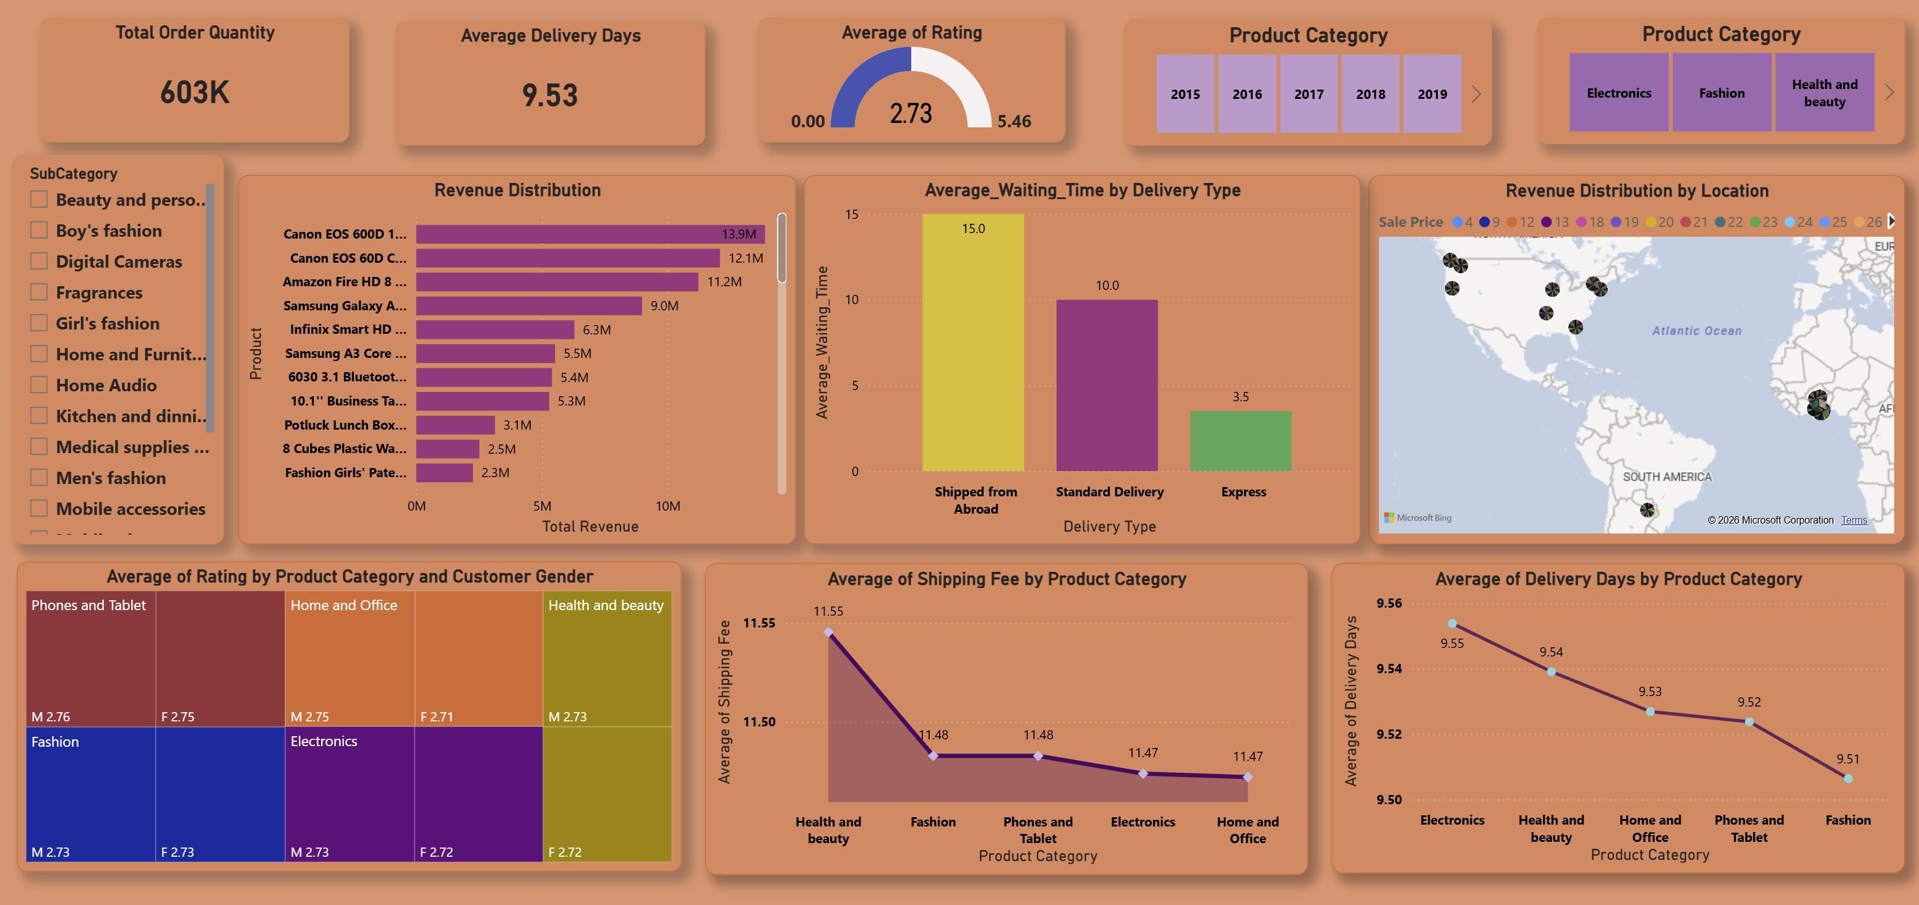
Individual Product Tab

Slide 16
Recommendation
Boost Retention: Implement loyalty programs with special rewards for repeat customers.
Strengthen Value: Enhance Prime benefits and deliver personalized promotions.
Leverage Analytics: Identify high-value customers to refine marketing strategies.
Utilize Feedback: Use customer insights to improve products and services.
Localize Marketing: Develop region-specific offers and strategic partnerships.
Drive Engagement: Adopt gamification, dynamic pricing, and interactive reward systems.

Slide 17
Conclusion
Amazon is performing strongly but must continue enhancing its competitive advantage and customer satisfaction.
Targeting high-value customers with tailored rewards can improve loyalty.
Using data analytics and customer feedback will drive continuous improvement in customer experience.
Expanding Prime benefits and personalized offers will help attract and retain customers.

Slide 18
Thank You

